Slide 1

Ordering
System
SMART RESTAURANT
Prepared by:
Lee Xing Yang A19EE0430
Supervised by:
LTs Dr Fauzan Khairi bin Che Harun

Slide 2
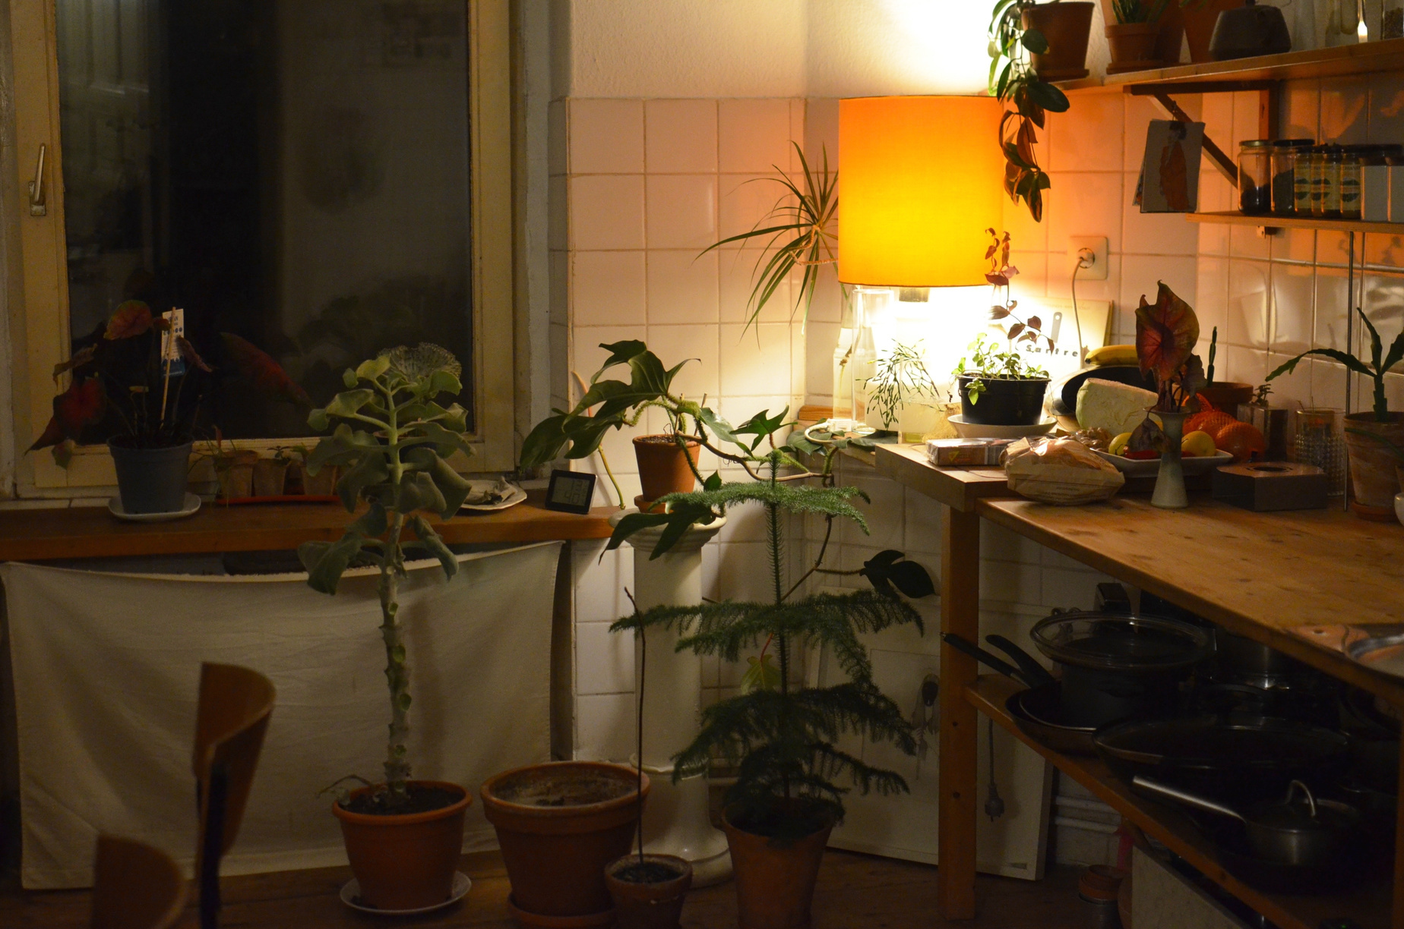
Introduction

Slide 3
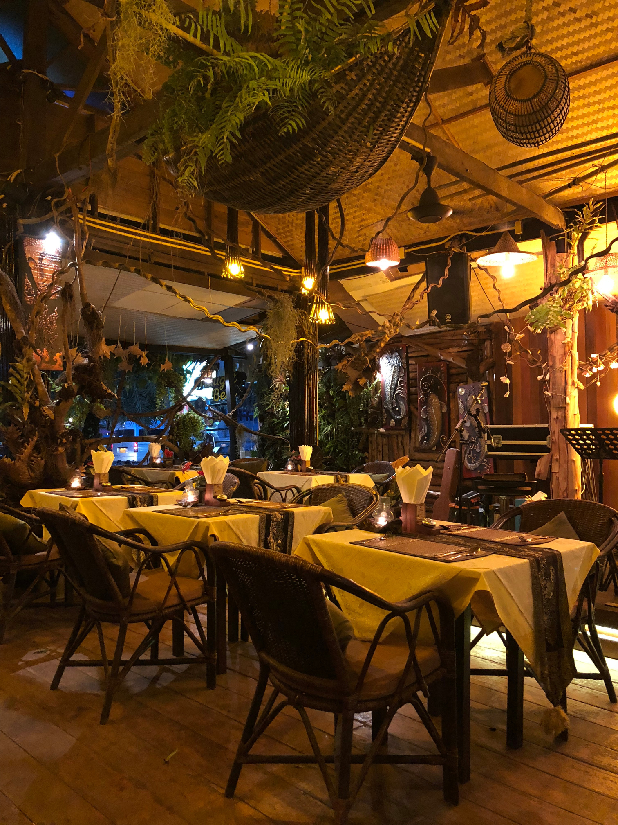






Typical flow of a restaurant (self collect)

Slide 4


Typical flow of a restaurant
(waiter)

Slide 5
Its pain!! When ......
Drive 30 minutes to the cafe and there is no seat for you
Queue for very long time
When you saw your dish, it is already cold (typically in campus cafe)
Cannot 100% focus on having social with friends because you listen to the table number
Waiters are very busy to do order especially at the peak time

Slide 6
Goal
To make people no need to queue to order foods
To free people from always listening to the queue numbers or food names
Reduce waiter's workload
The owner no need to shout
To lower the workload of waiter

Slide 7
Objective
To develop a webapp for people to order food
To make a database to store customer order
To use ESP32 to make a table reserve hardware
To use lcd to make a queue dashboard, so that people know which food is theirs
To notify the customer on their devices when their foods are ready to serve using the table device

Slide 8
Existing Attempt
Use web app to order dish (Menu Savvy)
(Self collect)will call the dish name/ put the food and wait for self collect/use digital dashboard to display table number (Mcd)

Slide 9
Literature Review
Research on NFC Based Menu App [1]
Develop an one stop smart system (Table Reserve, AI Menu, nearest restaurant feature named Foody [3]

Slide 10
Scope
The project is to design a one stop smart system from reserve, order, taking food to pay for the food.
Involve website development of front end, server and backend
Circuit design using Wifi Module,LCD Display
Involve programming such as C, Java Script, SQL, and PHP

Slide 11
What will be new?
Table reservation system (On table hardware)
Ringtone remind system
Dashboard which display food owner when multiple people collect food at counter

Slide 12
Let's dive into it!

Slide 13
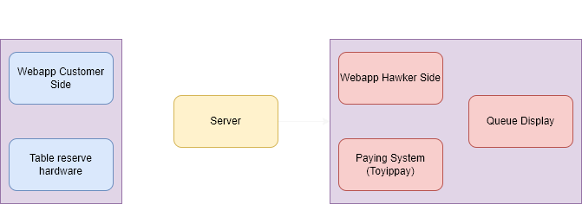
Methodology

Slide 14
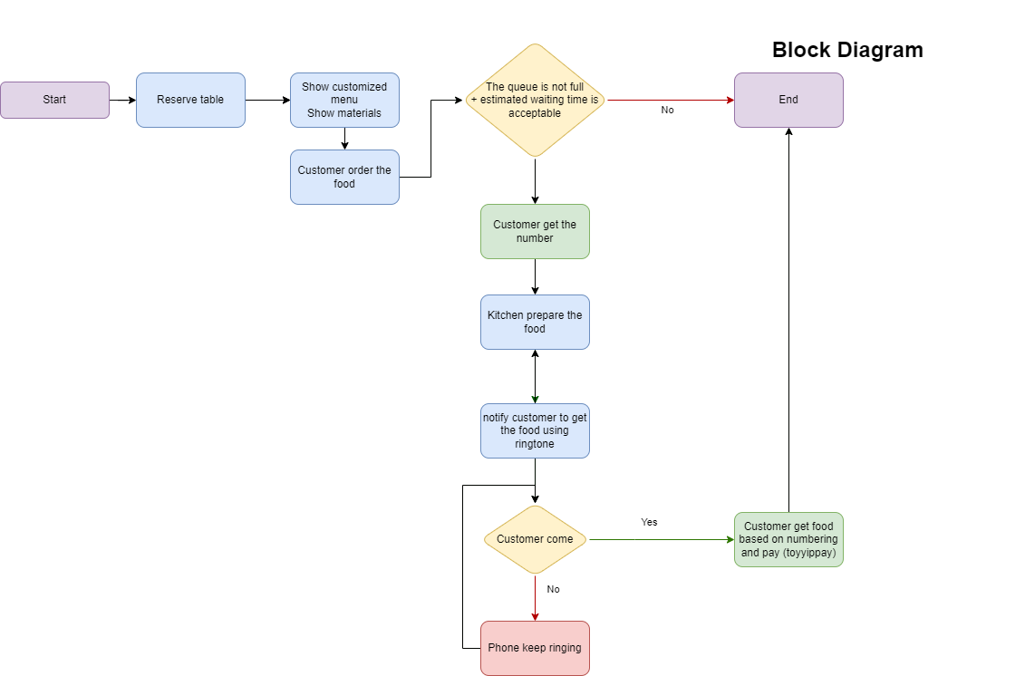
Methodology

Slide 15
Results

Slide 16
Webapp Customer Side......

Slide 17
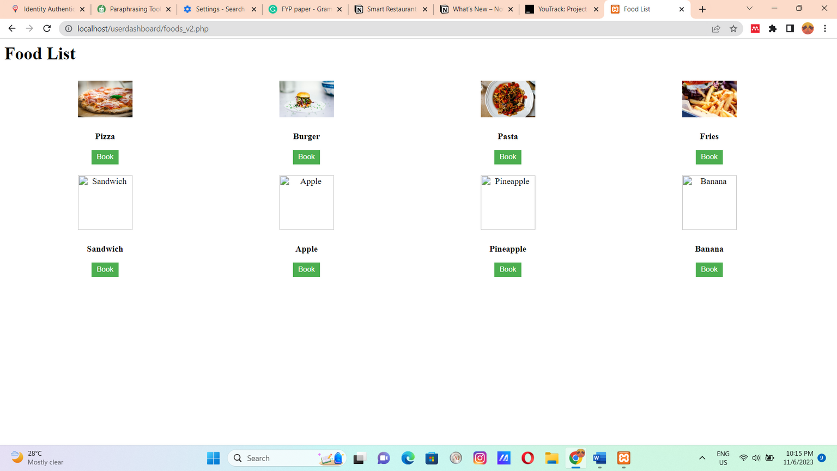
Food list

Slide 18
Webapp Hawker Side......

Slide 19
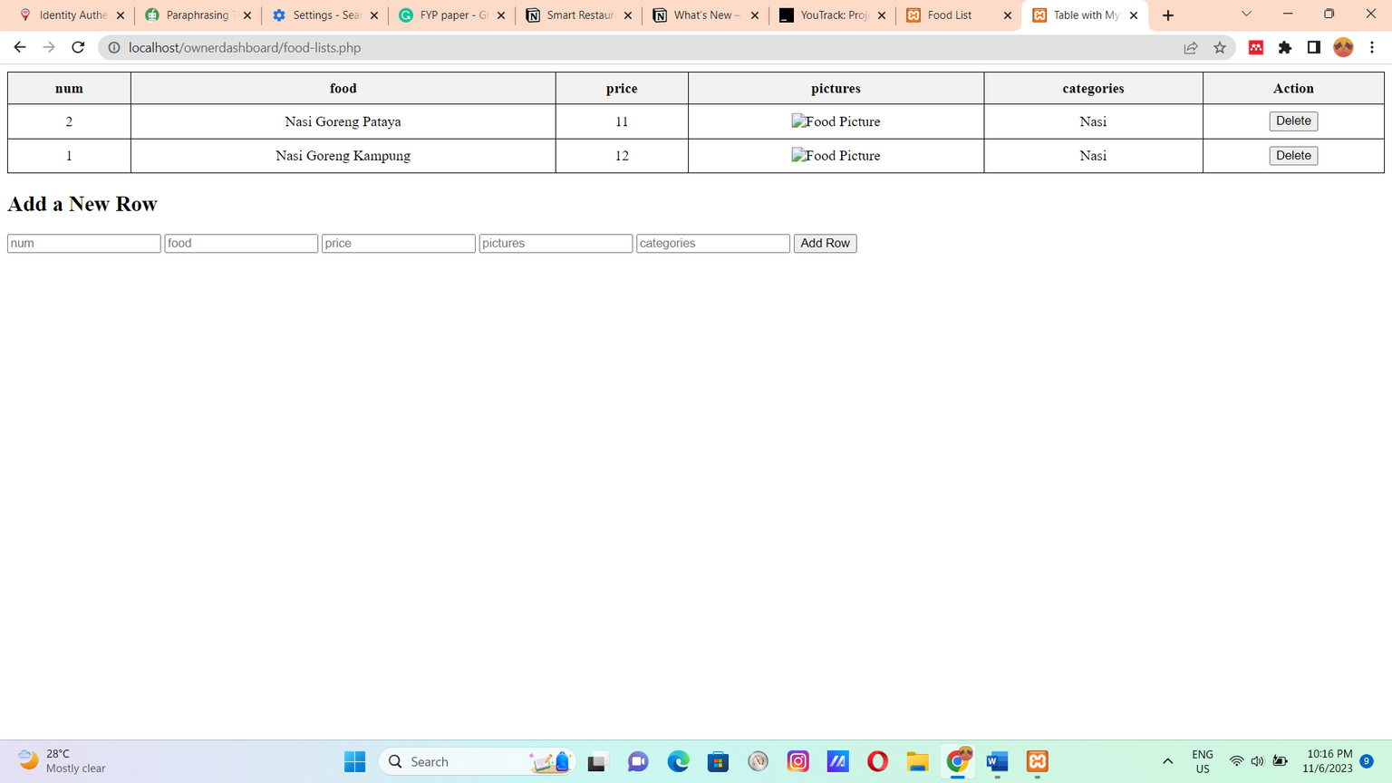
Food list

Slide 20
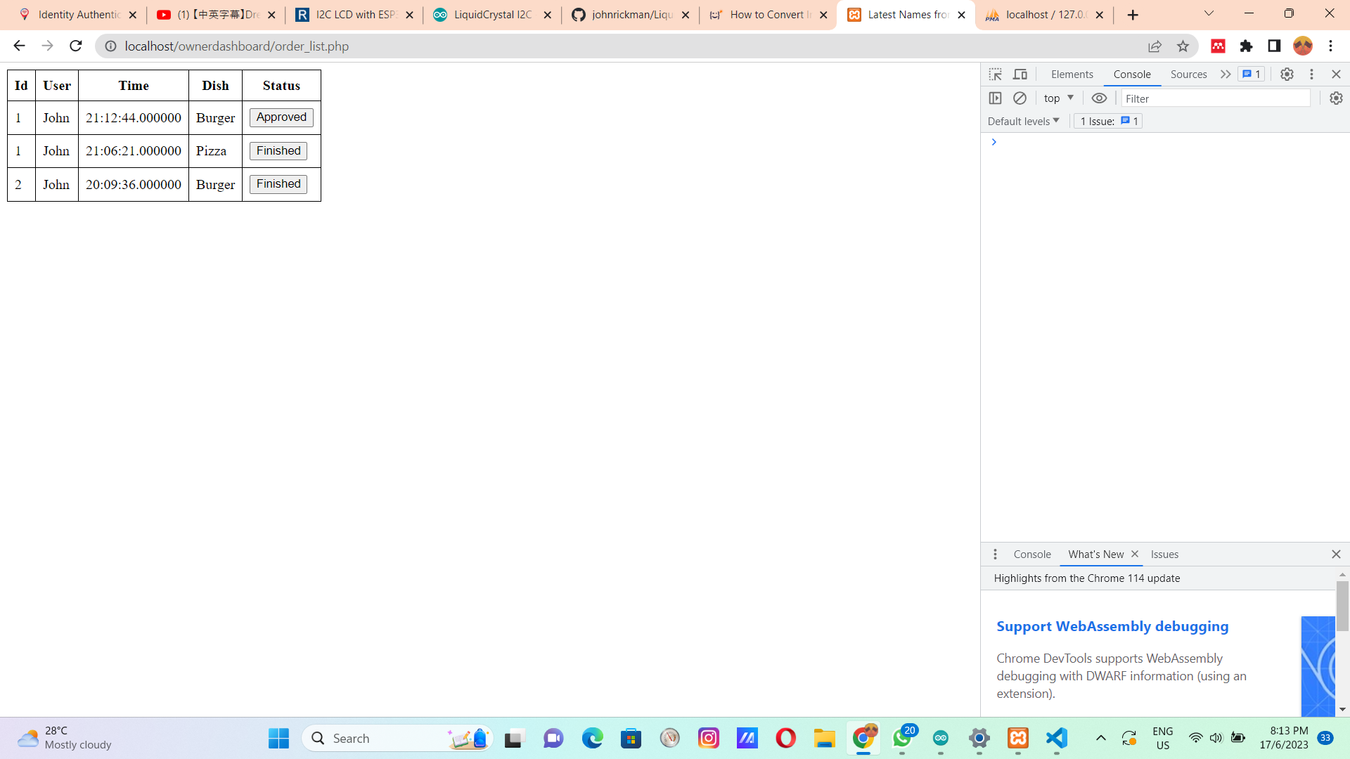
Customer list

Slide 21
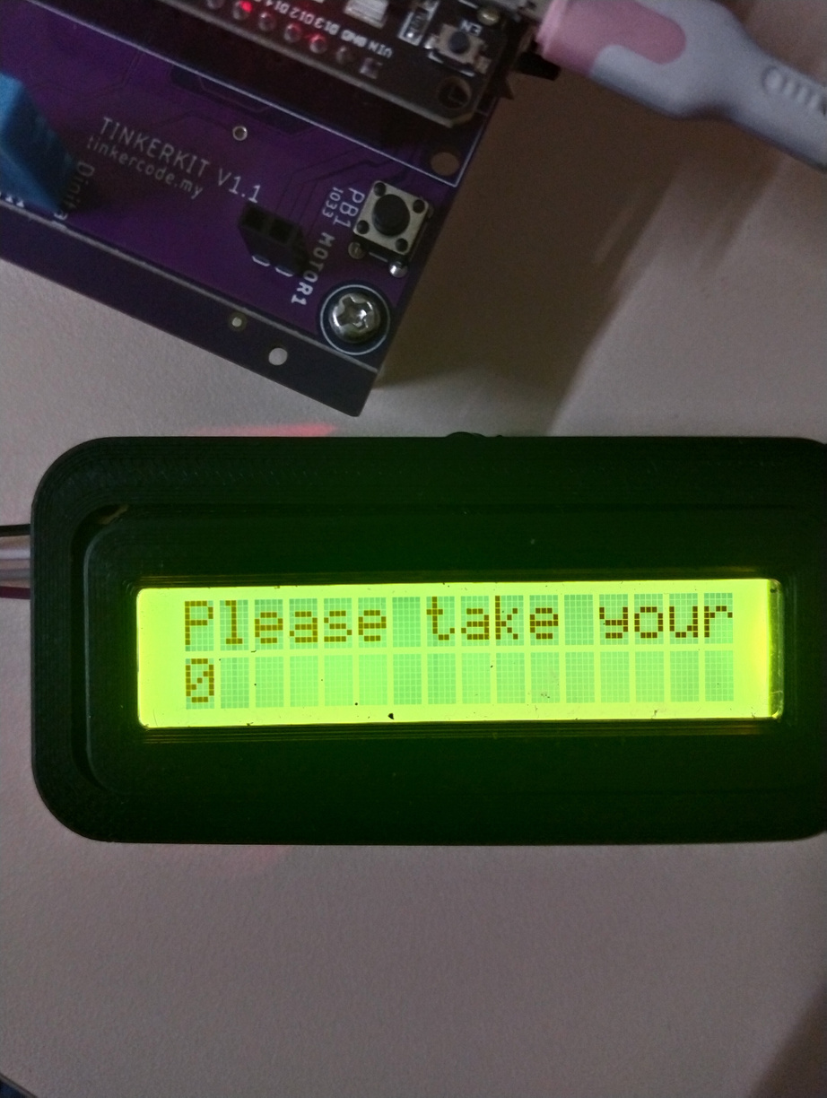
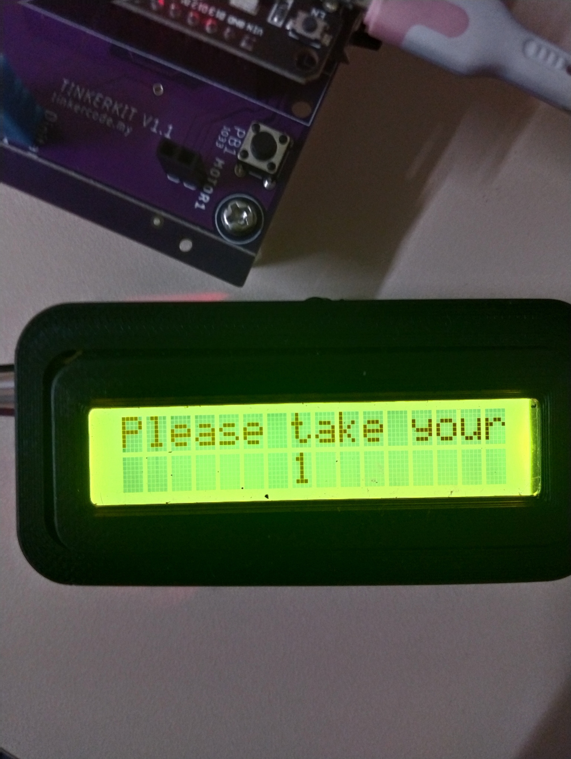
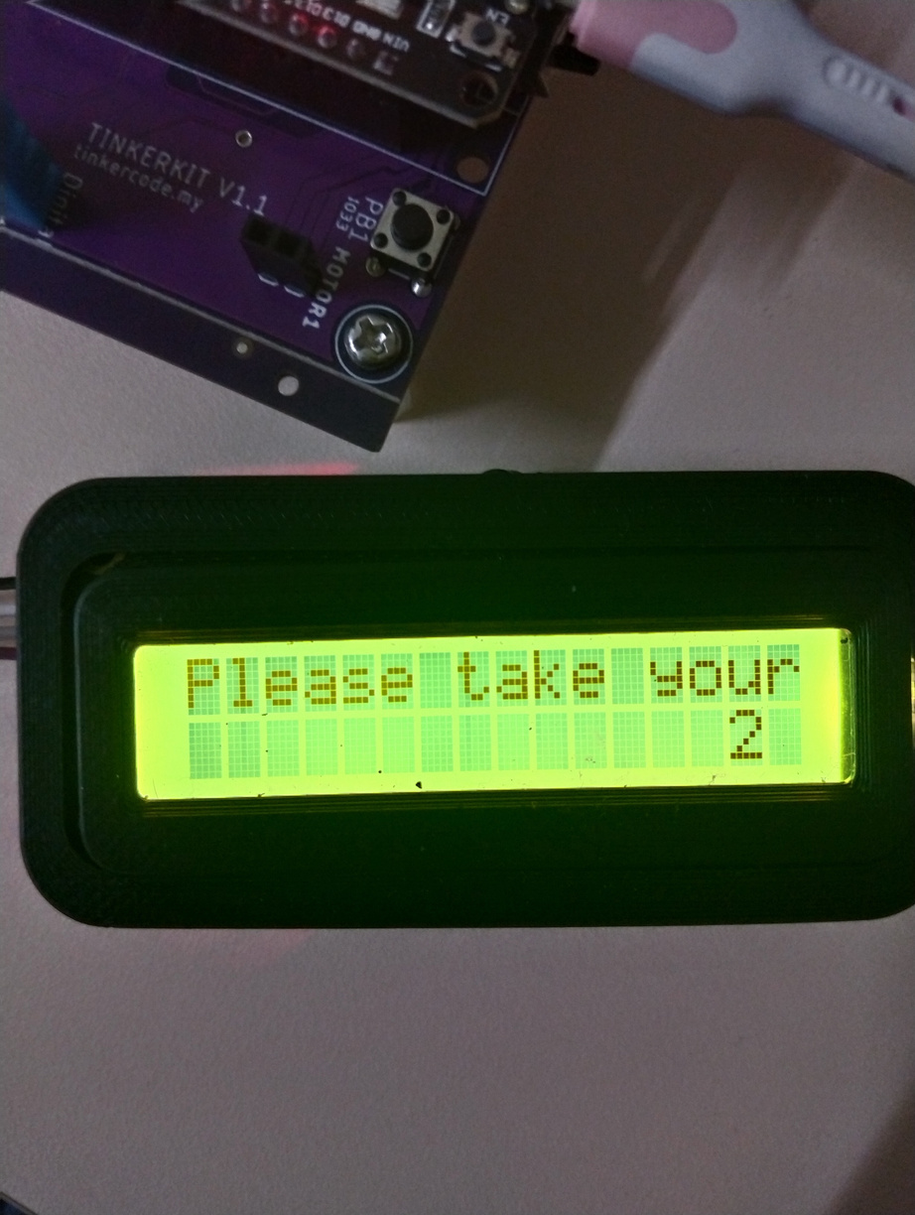

Queue position
Seat 0
Seat 1
Seat 2

Slide 22
Customer list

Slide 23
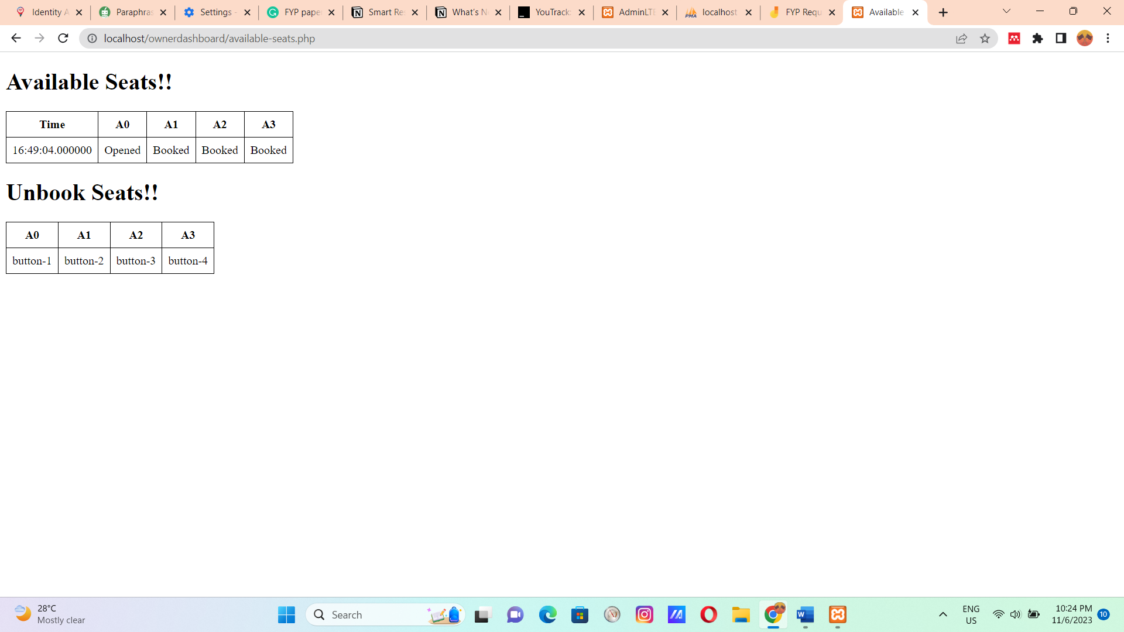
Table Number

Slide 24
Table Reservation Hardware

Slide 25
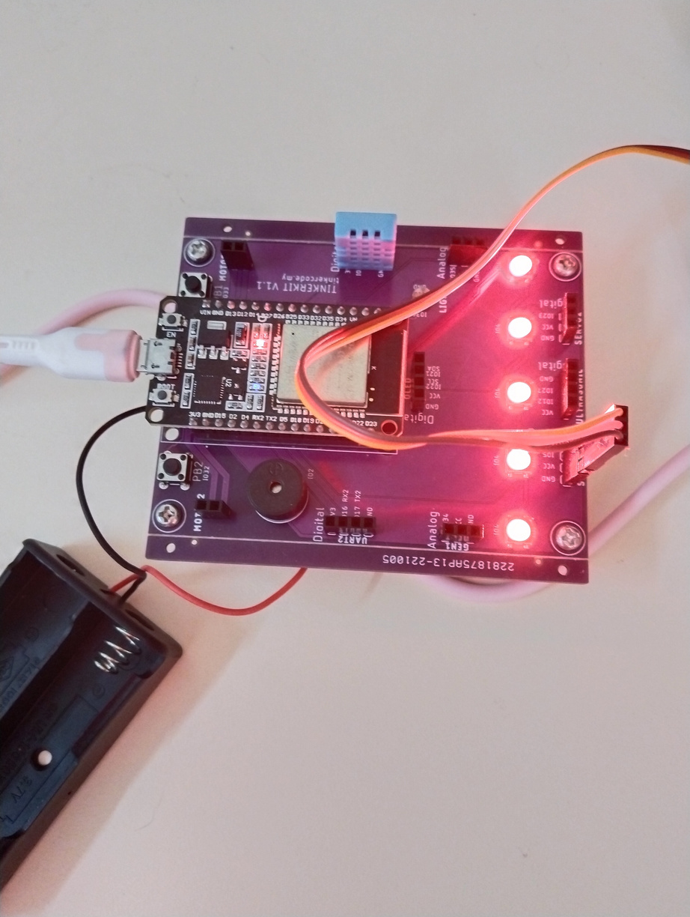

Slide 26
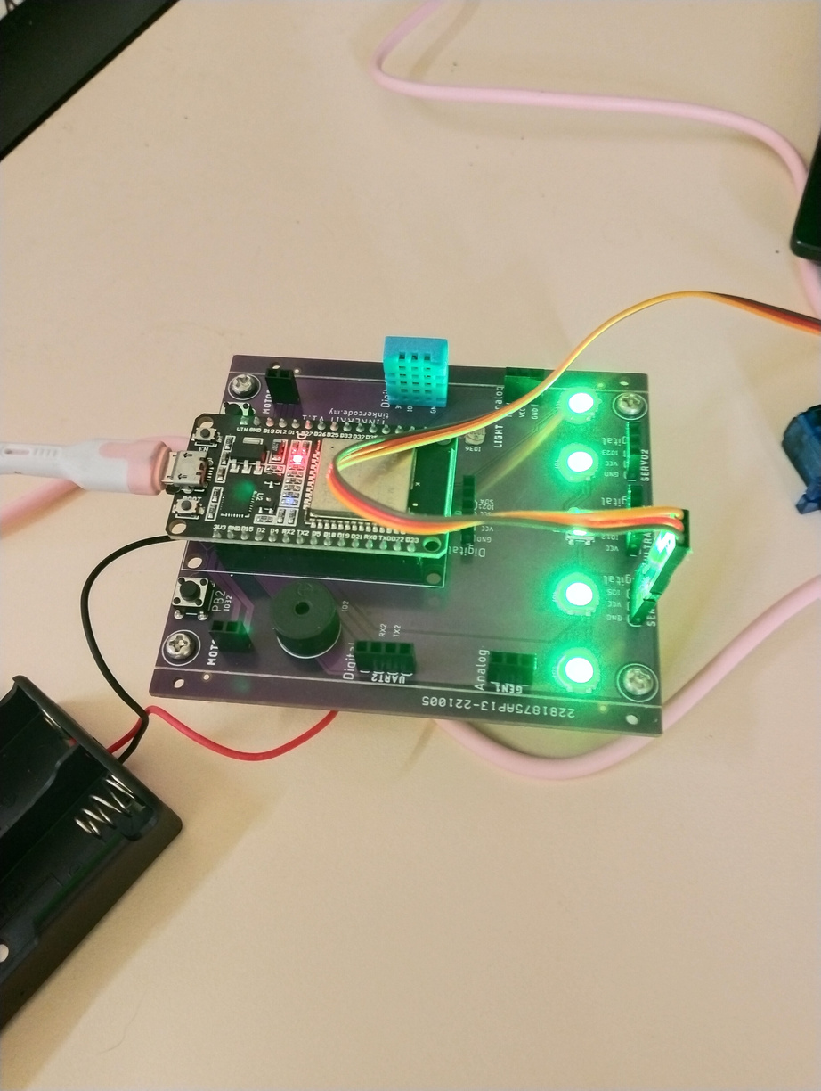

Slide 27
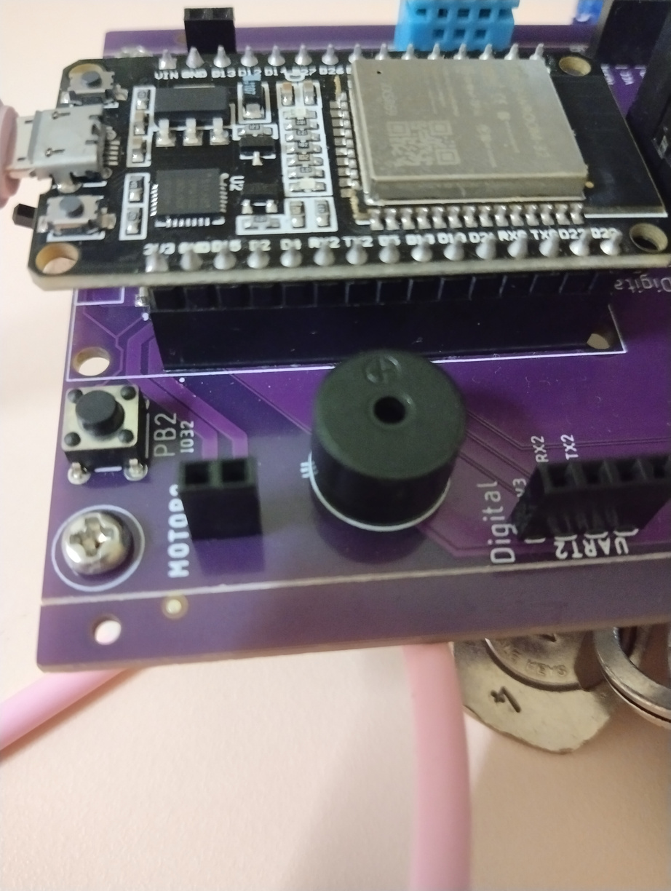


Slide 28
Queue Display

Slide 29
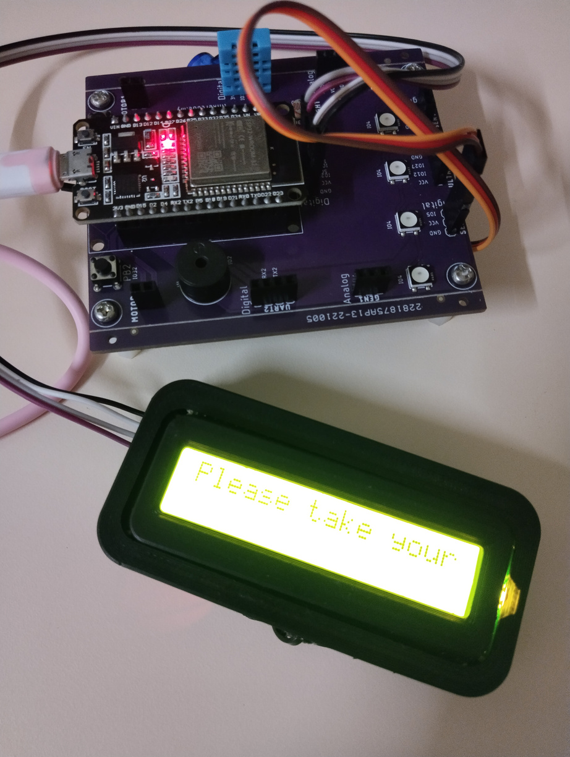

Slide 30
Conclusion

Slide 31
The project is to design a one stop smart system from reserve, order, taking food to pay for the food.

Slide 32
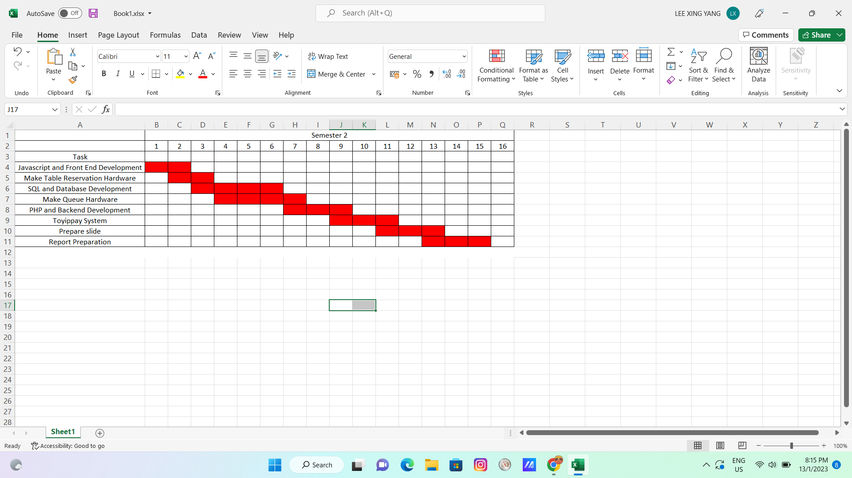
Gantt Chart (Semester 2)

Slide 33
References
[1] K. -Y. Lin, C. -H. Chen, Z. -M. Zhang and S. -C. Ou, "NFC-based mobile application design restaurant ordering system APP," 2018 IEEE International Conference on Applied System Invention (ICASI), 2018, pp. 737-740, doi: 10.1109/ICASI.2018.8394365.
[2] M. N. Mohammed, O. Y. M. Al-Rawi, S. Al-Zubaidi, S. Mustapha and M. Abdulrazaq, "Toward Sustainable Smart Cities in the Kingdom of Bahrain: A New Approach of Smart Restaurant Management and Ordering System During Covid-19," 2022 IEEE International Conference on Automatic Control and Intelligent Systems (I2CACIS), 2022, pp. 7-11, doi: 10.1109/I2CACIS54679.2022.9815479.
[3] V. Liyanage, A. Ekanayake, H. Premasiri, P. Munasinghe and S. Thelijjagoda, "Foody - Smart Restaurant Management and Ordering System," 2018 IEEE Region 10 Humanitarian Technology Conference (R10-HTC), 2018, pp. 1-6, doi: 10.1109/R10-HTC.2018.8629835.

